Slide 1
ADO.NET - Lesson 01
Introduction to ADO.NET
Training time: 10 minutes
Author: CuongNV3

Slide 2
Objectives
Learn what ADO.NET is.
Understand what a data provider is.
Understand what a connection object is.
Understand what a command object is.
Understand what a DataReader object is.
Understand what a DataSet object is.
Understand what a DataAdapter object is.

Slide 3
ADO.NET
ADO.NET is an object-oriented set of libraries that allows you to interact with data sources.
The data source is a database, it could also be a text file, an Excel spreadsheet, or an XML file.
There are many different types of databases available. For example, there is Microsoft SQL Server, Microsoft Access, Oracle, Borland Interbase, and IBM DB2, just to name a few.
In this course: we will look at ADO.NET as a way to interact with a database Microsoft SQL Server

Slide 4
Data Providers
ADO.NET allows us to interact with different types of data sources and different types of databases.
There isn't a single set of classes that allow you to accomplish this universally
ADO.NET provides a relatively common way to interact with data sources, but comes in different sets of libraries for each way you can talk to a data source. These libraries are called Data Providers and are usually named for the protocol or data source type they allow you to interact with.

Slide 5
Data Providers (2)
ADO.NET Data Providers are class libraries that allow a common way to interact with specific data sources or protocols. The library APIs have prefixes that indicate which provider they support.
Provider Name | API prefix | Data Source Description
ODBC Data Provider | Odbc | Data Sources with an ODBC interface. Normally older data bases.
OleDb Data Provider | OleDb | Data Sources that expose an OleDb interface, i.e. Access or Excel.
Oracle Data Provider | Oracle | For Oracle Databases.
SQL Data Provider | Sql | For interacting with Microsoft SQL Server.
Borland Data Provider | Bdp | Generic access to many databases such as Interbase, SQL Server, IBM DB2, and Oracle.

Slide 6
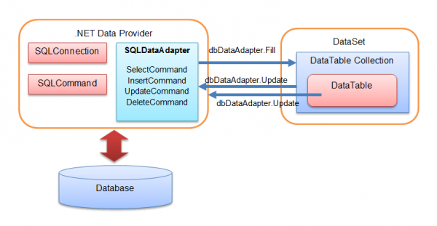
ADO.NET Objects
ADO.NET data access architecture

Slide 7
The SqlConnection Object
To interact with a database, you must have a connection to it.
The connection helps identify the database server, the database name, user name, password, and other parameters that are required for connecting to the data base.
A connection object is used by command objects so they will know which database to execute the command on.

Slide 8
The SqlCommand Object
You use a command object to send SQL statements to the database.
A command object uses a connection object to figure out which database to communicate with. You can use a command object alone, to execute a command directly, or assign a reference to a command object to an SqlDataAdapter.

Slide 9
The SqlDataReader Object
The data reader object allows you to obtain the results of a SELECT statement from a command object.
The data returned from a data reader is a fast forward-only stream of data, you can only pull the data from the stream in a sequential manner.
This is good for speed, but if you need to manipulate data, then a DataSet is a better object to work with.

Slide 10
The DataSet Object
DataSet objects are in-memory representations of data. They contain multiple Datatable objects, which contain columns and rows, just like normal database tables. You can even define relations between tables to create parent-child relationships.
The DataSet is specifically designed to help manage data in memory and to support disconnected operations on data, when such a scenario make sense. The DataSet is an object that is used by all of the Data Providers.

Slide 11
The SqlDataAdapter Object
Some situations also call for caching data in memory to minimize the number of database calls for data that does not change. The data adapter makes it easy for you to accomplish these things by helping to manage data in a disconnected mode.
The data adapter fills a DataSet object when reading the data and writes in a single batch when persisting changes back to the database.

Slide 12
The SqlDataAdapter Object (2)
A data adapter contains a reference to the connection object and opens and closes the connection automatically when reading from or writing to the database.
The data adapter contains command object references for SELECT, INSERT, UPDATE, and DELETE operations on the data.
You will have a data adapter defined for each table in a DataSet and it will take care of all communication with the database for you. All you need to do is tell the data adapter when to load from or write to the database.

Slide 13
Summary
ADO.NET is the .NET technology for interacting with data sources.
There are several Data Providers, which allow communication with different data sources, depending on the protocols they use or what the database is.
The SqlConnection object lets you manage a connection to a data source
SqlCommand objects allow you to talk to a data source and send commands to it
To have fast forward-only read access to data, use the SqlDataReader
If you want to work with disconnected data, use a DataSet and implement reading and writing to/from the data source with a SqlDataAdapter.

Slide 14
Q&A
Thanks!

